Slide 1
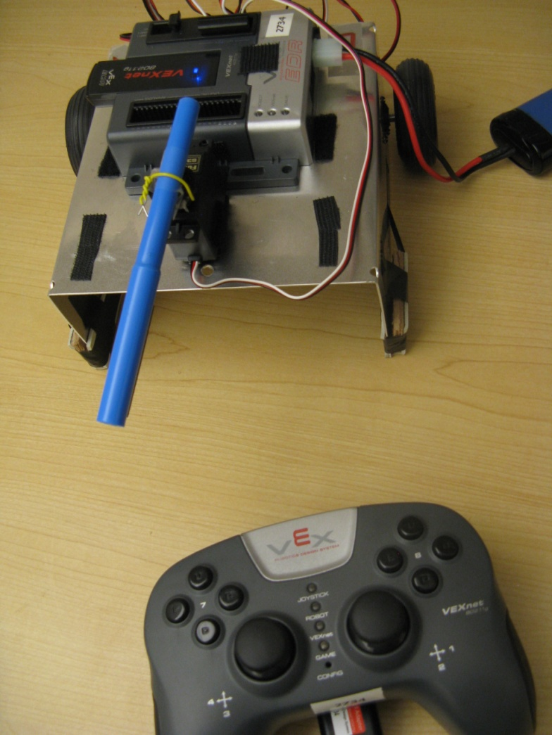

Simulink Support for VEX Cortex
BEST Robotics
Sandeep Hiremath

Slide 2
Outline
Intro to Simulink
  Launching and Navigating through the software
  Creating a simple robot program
  Simulating and Debugging robot programs
  Advanced Logic Design
3D Virtual Worlds
Access to the software
Software Installation
More Training Resources

Slide 3
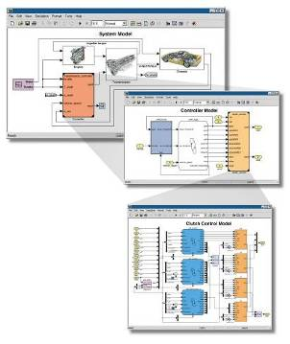
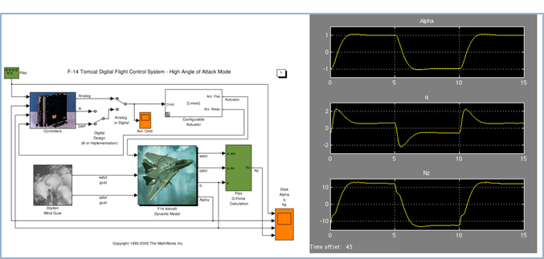
What is Simulink?
Simulink is a software package for modeling, simulating, and testing the BEST robot program.
Notes:
First lets introduce Simulink and what it can do.
Simulink is a Block-diagram environment
Where you can model and simulate dynamic, linear, nonlinear systems.
It lets you accurately design, implement, and test:
Control systems
Signal processing systems
Communications systems
And other time-varying systems
We can talk about Simulink both as a product and within the context of other tools that use Simulink as a platform for Model-Based Design. Lets make that distinction now, by first discussing the key features of Simulink the product.

Slide 4
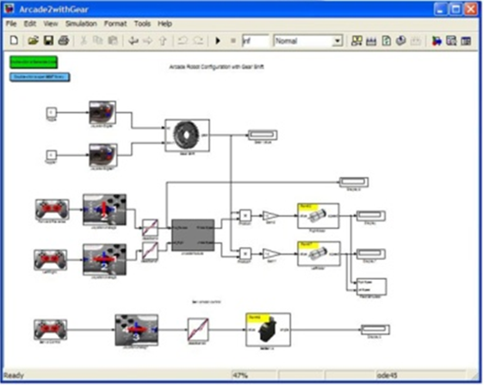
Why Simulink?
Simple Programming Interface
  - Easy to use interface
  - Graphical drag and drop
  - NO prior programming knowledge required
More Efficient Design Flow
  Parallel development
  No waiting for robot to be built
Simulation and Debug
  - Test your program without hardware
  - What-if scenarios are easy
Advanced Programming also
  - Stateflow
  - Embedded MATLAB code

Slide 5
Why Simulink?
Used in Engineering curriculum all over the world (~4000 schools) –MATLAB and Simulink
Used in many robotics, aerospace and automotive student competitions - http://www.mathworks.com/academia/student-competitions/
Many K-12 teachers are now using MATLAB and Simulink for teaching in classroom
  MATLAB at Trinity Schools
  View how secondary students learn science and math interactively.

Slide 6
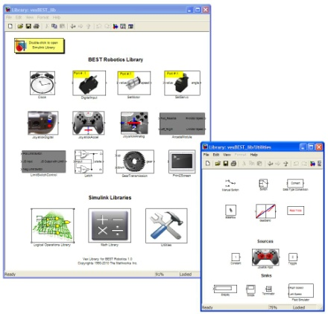
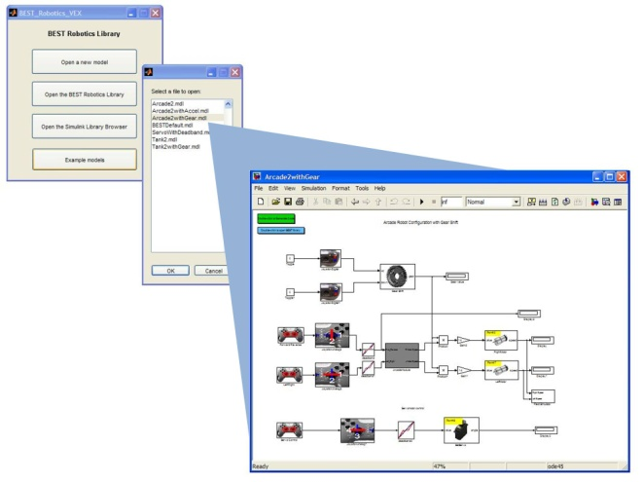
Simulink and BEST Library
BEST Robotics Library
Learn more: http://www.mathworks.com/products/demos/academia/simulink-quick-start/
Notes:
Simulink – Quick why?
BEST Library –
Where can you learn more from?

Slide 7
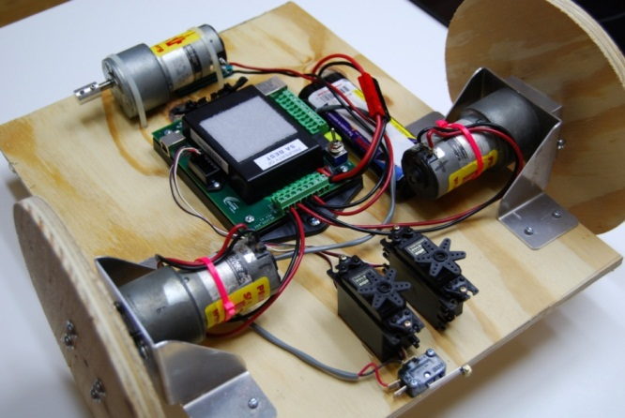
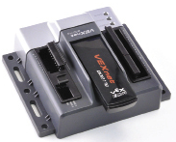
Sample Robot
3 big motors
2 servos
Switch
Right motor –
Left motor –
Arm motor –
Notes:
Need to change this based on proto-robot

Slide 8
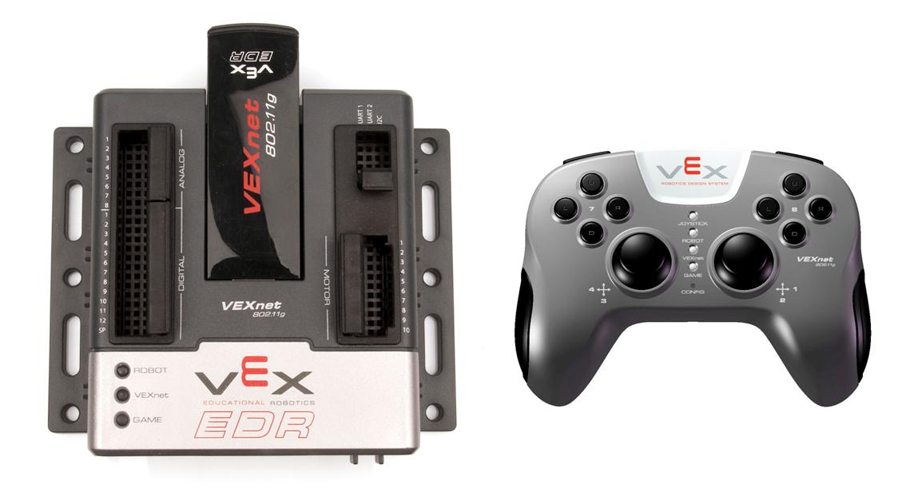
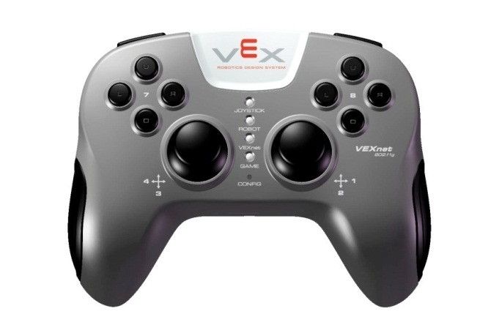
Lets Build!
Tank Robot Configuration
  tank2.mdl (Example model)
2 vertical axes control the 2 wheels
Joystick Control
Your Robot
Robot Program / Behavior

Slide 9
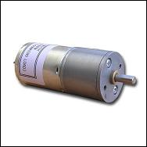
Lets Build!
Tank Robot Configuration
  tank2.mdl (Example model)
Two Vertical Axes
VEX Cortex
Two Motors
Right Motor
Pin 2
Left Motor
Pin 9
Robot Program / Behavior

Slide 10
VEX Controller/Gamepad

Slide 11
VEX Microcontroller

Slide 12
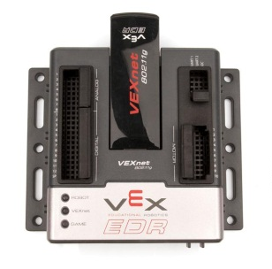
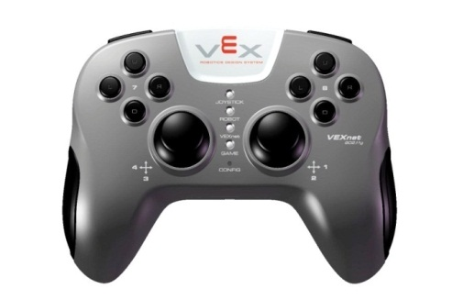
Setup

Slide 13
New terms
Simulink model – robot program
Block – command or function
Library – group of blocks or commands
Generate code - Auto generate C code from the Simulink model
Run a Simulink model – ‘Simulate’ a program on PC

Slide 14
What is Simulation?
Simulation is the imitation of some real thing, state of affairs, or process.
Model of
Behavior
Stimulus
Response
What if we do this?
Imitate the robot behavior
What will the robot do?

Slide 15

Gamepad Input to program

Slide 16
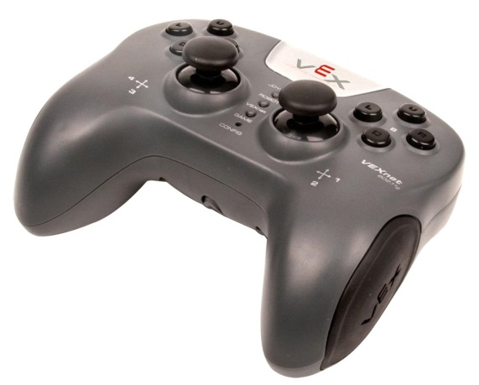
Gamepad Input to Simulink
VEX Controller NOT supported

Slide 17

Gamepad Input to Simulink
Logitech Gamepad F310

Slide 18

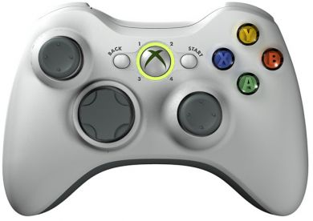
Gamepad Input to Simulink
Xbox Controller!!

Slide 19

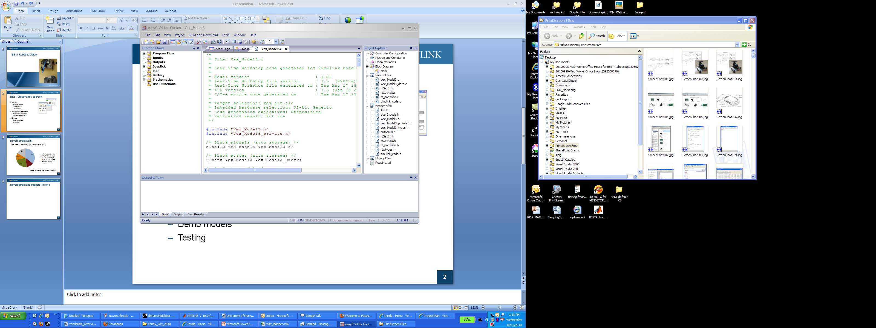
Workflow Summary
Simulation/Testing
Simulink Model
Hardware
BEST VEX Library
Auto Code Generation- easyC

Slide 20
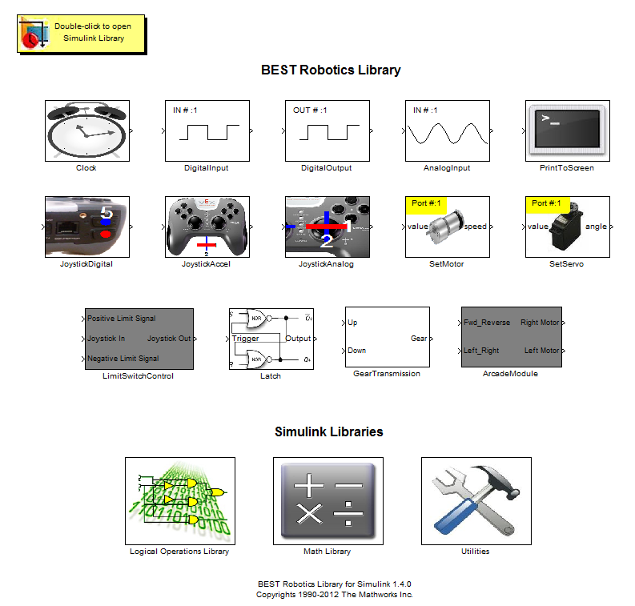
Overview - BEST Library

Slide 21
Advanced Programming
Stateflow
  Demo:
    Tank2withGear.mdl
    Aracde2withGear.mdl
  Blocks:
    Latch
    Gear Transmission
Using Embedded MATLAB function block
  Demo:
    Teank2withGear_EML.mdl
  Blocks:
    Utilities library -> MATLAB Function

Slide 22
Getting access to software
Request software here: https://goo.gl/e5bGM2
Create your account at www.mathworks.com
Online download of all software & support packages
No special paperwork
1-year full access

Slide 23
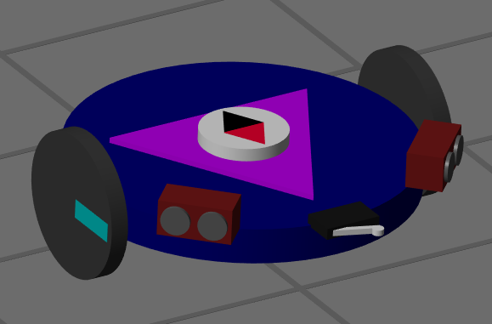
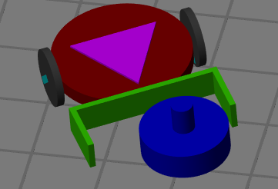
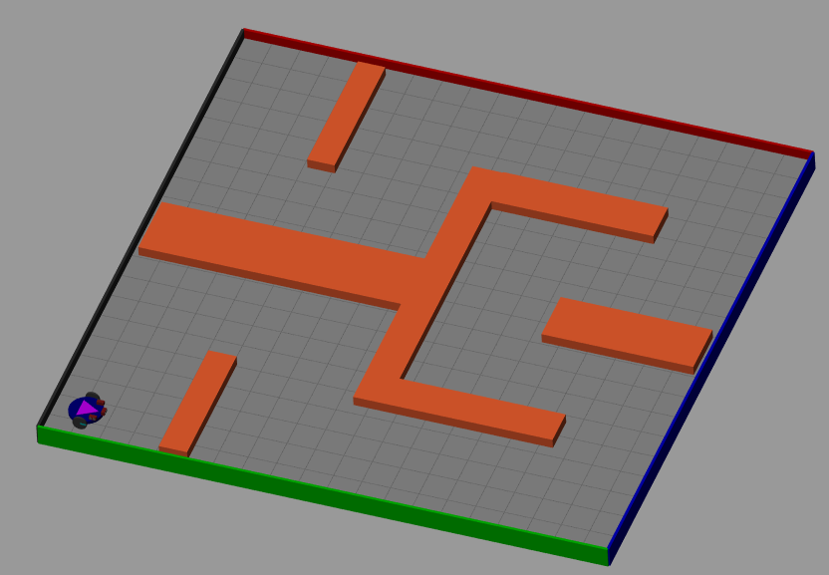
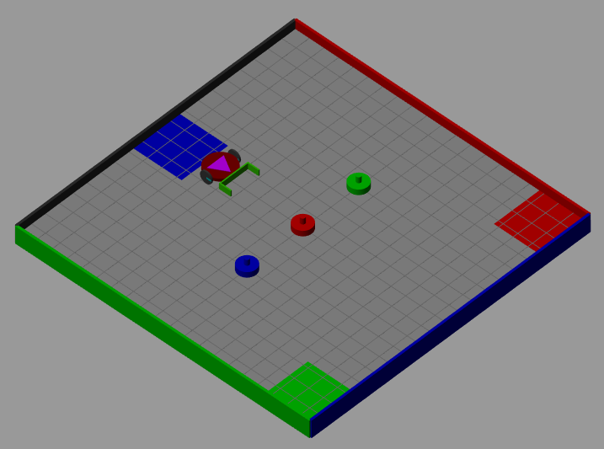
3D Virtual Worlds- Robotics Playground
Start programming without a robot
Simulink library of blocks and environments
Test your models before uploading to hardware
Self-paced Simulink lessons
Download:
  mathworks.com/matlabcentral/fileexchange/67157-robotics-playground

Slide 24
Software and Installation
System Requirements:
  Windows XP or later version (Vista, 7)
  Could be 32-bit or 64-bit machines
Contact: passcompetitions@mathworks.com

Slide 25
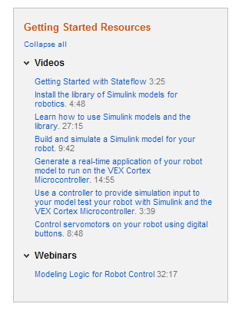
Training Resources
Facebook forum
  facebook.com/groups/PASScompetitions
Video Tutorials available
  www.bestinc.org > Participants > Resources
On Demand online training–
  Customized for teams
  Q&A
Contact
  passcompetitions@mathworks.com

Slide 26
BEST Simulink Design Award
One team per region recognized for the best robot program designed using Simulink.
Every submission
  A Simulink file
  A short (fun+ technical) video

Slide 27

Thank you!

