Slide 1
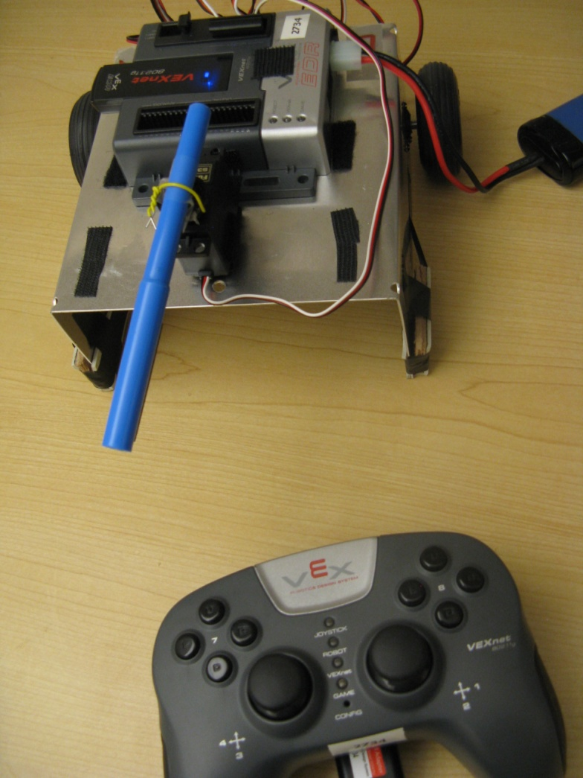

Simulink Support for VEX Cortex
BEST Robotics 2012
Sandeep Hiremath

Slide 2
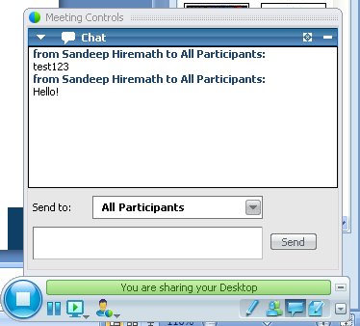
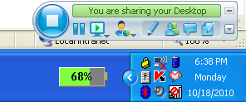
WebEx
I was on the road and could provide my comments only this
Chat

Slide 3
Outline
Intro to Simulink
Simulink software support for VEX
  Launching and Navigating through the software
  Creating a simple robot program
  Simulating and Debugging robot programs
  Advanced Programming
Access to the software
Software Installation
More Training Resources

Slide 4
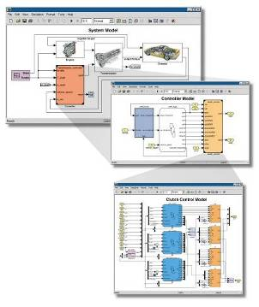
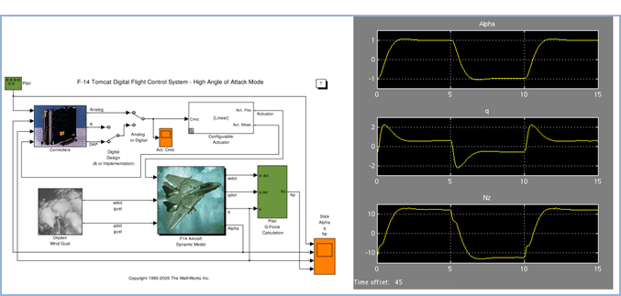
What is Simulink?
Simulink is a software package for modeling, simulating, and testing the BEST robot program.
Notes:
First lets introduce Simulink and what it can do.
Simulink is a Block-diagram environment
Where you can model and simulate dynamic, linear, nonlinear systems.
It lets you accurately design, implement, and test:
Control systems
Signal processing systems
Communications systems
And other time-varying systems
We can talk about Simulink both as a product and within the context of other tools that use Simulink as a platform for Model-Based Design. Lets make that distinction now, by first discussing the key features of Simulink the product.

Slide 5
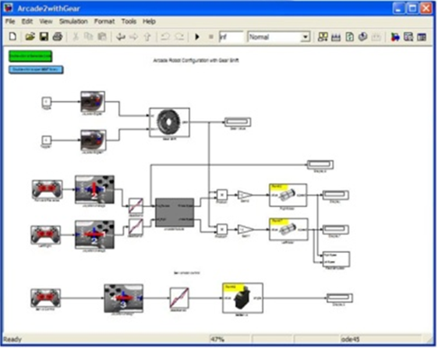
Why Simulink?
Simple Programming Interface
  - Easy to use interface
  - Graphical drag and drop
More Efficient Design Flow
  Parallel development
  No waiting for robot to be built
Simulation and Debug
  - Test your program without hardware
  - What-if scenarios are easy
Advanced Programming also
  - Stateflow
  - Embedded MATLAB code

Slide 6
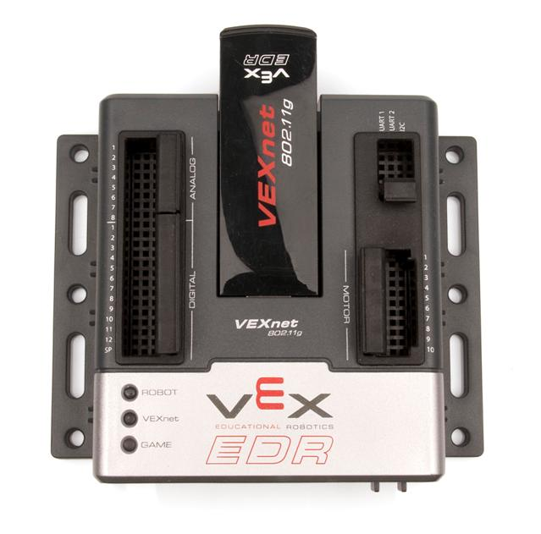
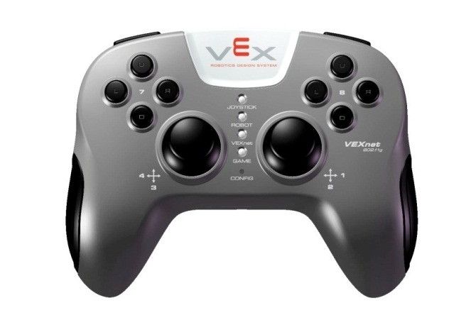
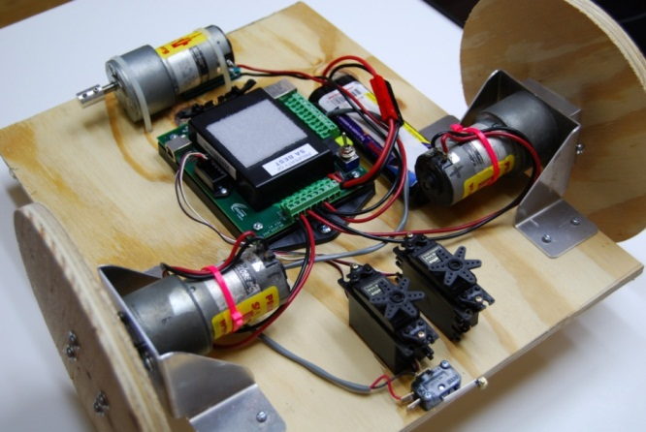
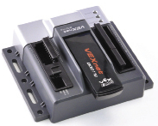
Lets Build!
Tank Robot Configuration
  tank2.mdl (Example model)
2 vertical axes control the 2 wheels
Joystick Control
Your Robot
Robot Program / Behavior

Slide 7
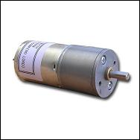
Lets Build!
Tank Robot Configuration
  tank2.mdl (Example model)
Two Vertical Axes
VEX Cortex
Two Motors
Right Motor
Pin 2
Left Motor
Pin 9
Robot Program / Behavior

Slide 8
New terms
Simulink model – robot program
Block – command or function
Library – group of blocks or commands
Generate code - Auto generate C code from the Simulink model
Run a Simulink model – ‘Simulate’ a program on PC

Slide 9
What is Simulation?
Simulation is the imitation of some real thing, state of affairs, or process.
Model of
Behavior
Stimulus
Response
What if we do this?
Imitate the robot behavior
What will the robot do?

Slide 10
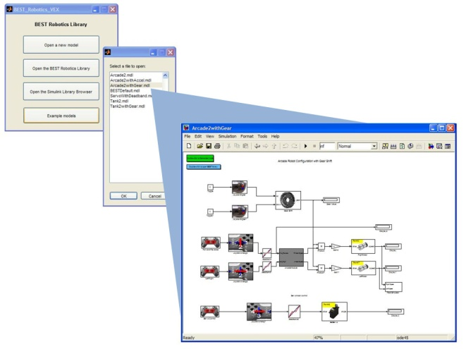

Gamepad Input to program

Slide 11
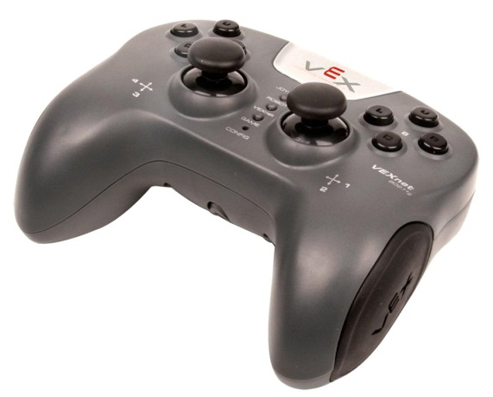
Gamepad Input to Simulink
VEX Controller NOT supported

Slide 12

Gamepad Input to Simulink
Logitech Gamepad F310

Slide 13

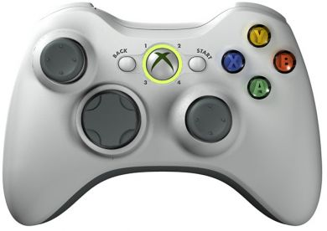
Gamepad Input to Simulink
Xbox Controller!!
(shiremat@mathworks.com)

Slide 14

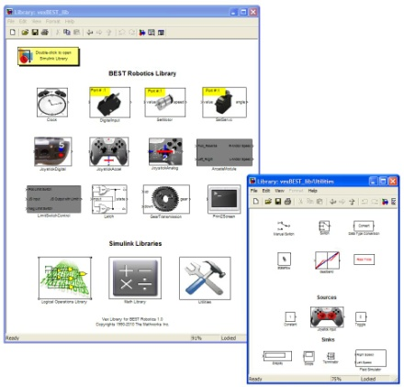
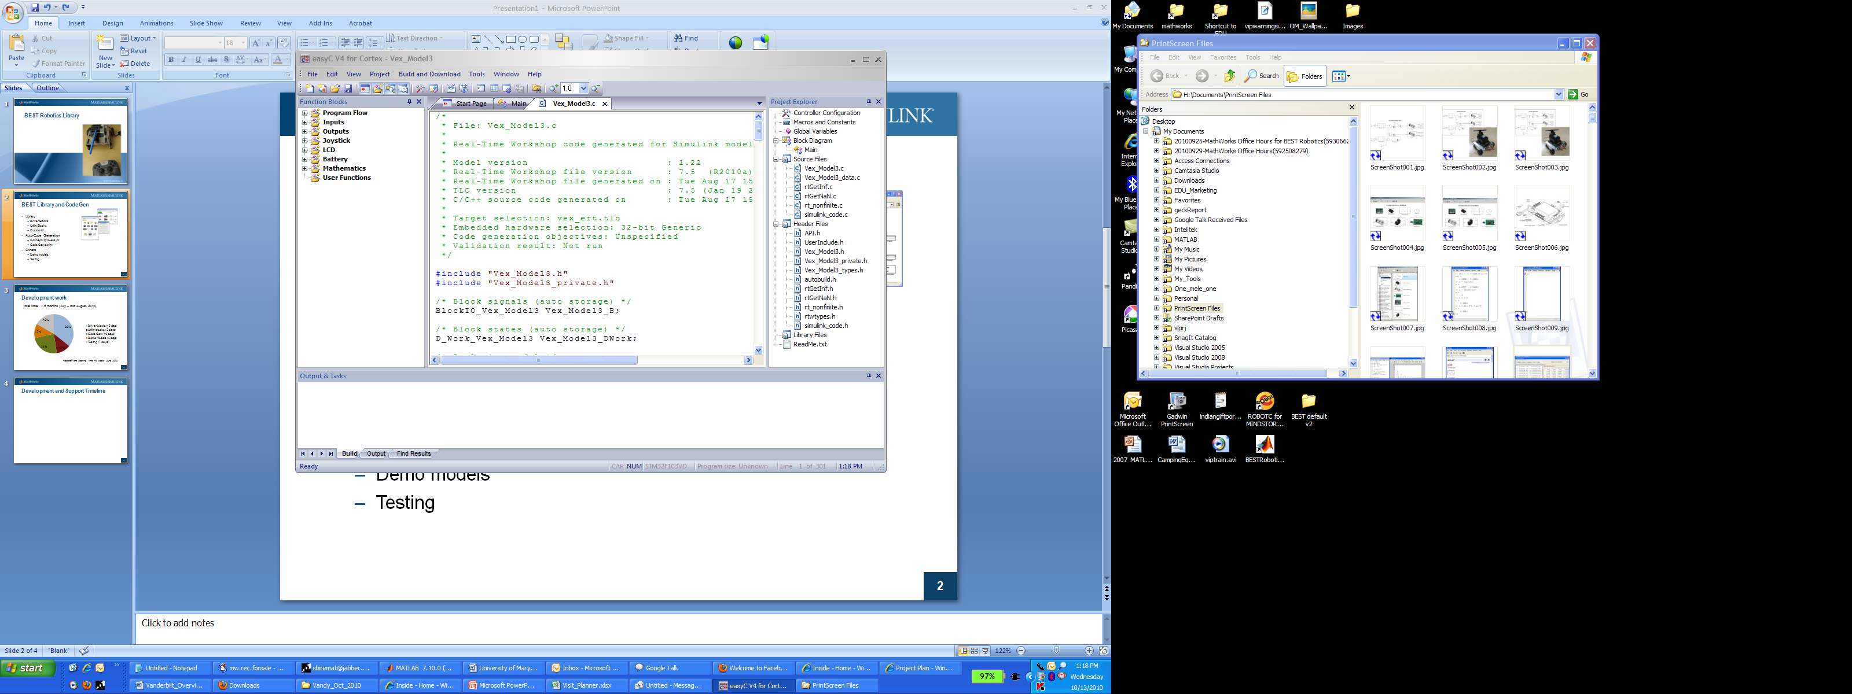
Workflow Summary
Simulation/Testing
Simulink Model
Hardware
BEST VEX Library
Code Generation- easyC

Slide 15
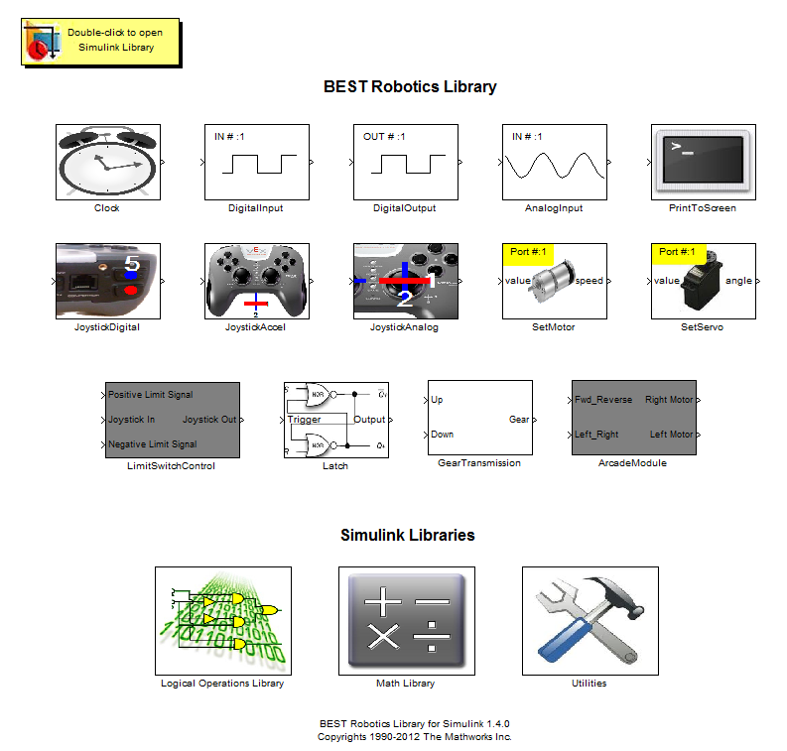
Overview - BEST Library

Slide 16
Advanced Programming
Stateflow
  Demo:
    Tank2withGear.mdl
    Aracde2withGear.mdl
  Blocks:
    Latch
    Gear Transmission
Using Embedded MATLAB function block New!!
  Demo:
    Teank2withGear_EML.mdl
  Blocks:
    Utilities library -> MATLAB Function

Slide 17
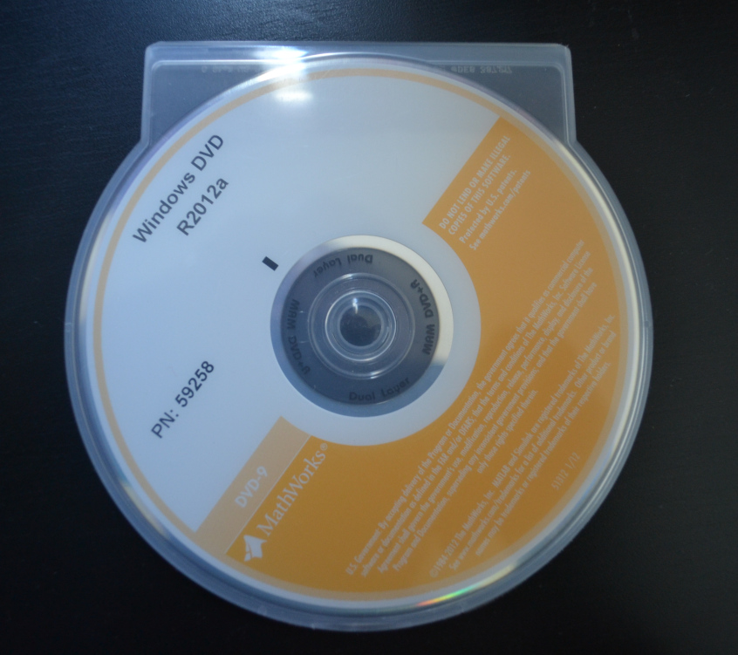
Access to software
Contact your Hub Directors for DVDs
2 DVDs per team
Each team has 10 installations
Label has a URL – Installation instructions
No online download available
No Paperwork
1-year access

Slide 18

Installation
Label on the DVD has a web address (URL) and installation/activation keys
Go to the URL on your PC and FOLLOW the instructions there to install the software
2 steps = 2 installers (install both as per instructions)
System Requirements:
  Windows XP or later version (Vista, 7)
  Could be 32-bit or 64-bit machines
  Need ‘easy C’ to download the program to
  VEX hardware (easyC Cortex V4)
Label

Slide 19
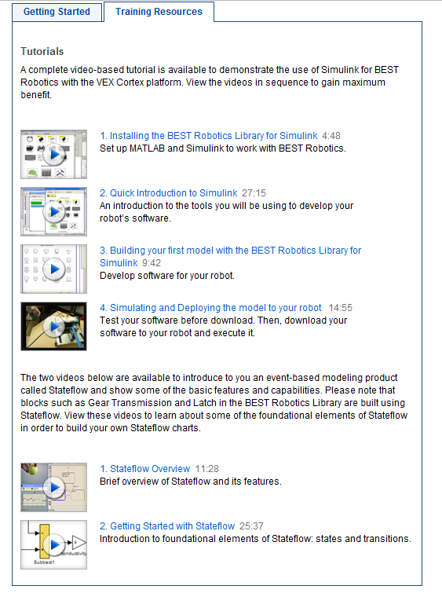
Training Resources
Weekly WebEx training – Info on BRI home page
Video Tutorials available
  www.bestinc.org > Participants > Resources
Custom training for teams
Contact
  bestrobotics@mathworks.com

Slide 20

Thank you!

Slide 21
Things to Note
No paperwork!
Annual License
Access- Contact Hub Directors (2nd week of July)
FOLLOW instructions to install
Windows only (Win XP or later versions)
Useful simulation features for debugging on PC
Contact Technical Support if any errors or issues.

Slide 23
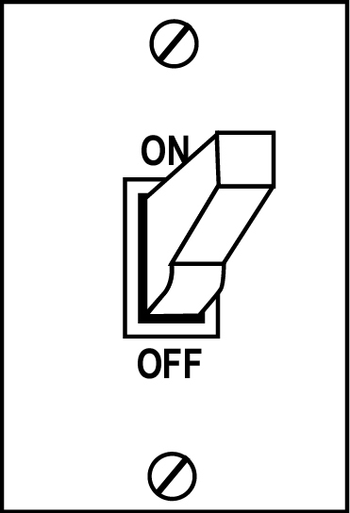
Simple switch example
button0 = down
If (button is up)
set state = ON
Else (button is down)
set state = OFF

Slide 24
Stateflow model
off
down
up
on

