Slide 1
The BEST IR Sensor System
BEST Robotics 2019

Slide 2
Introduction
The BEST IR Sensor System will be valuable for the “Off the Grid” Challenge.
Click on the video below to see this year's challenge.

Slide 3
Infrared light
The IR Sensor System uses Infrared radiation (IR), sometimes called infrared light. Infrared light is electromagnetic radiation with longer wavelengths than those of visible light. This makes it invisible to the human eye. One of the most useful applications of the IR spectrum is in sensing and detection.

Slide 4
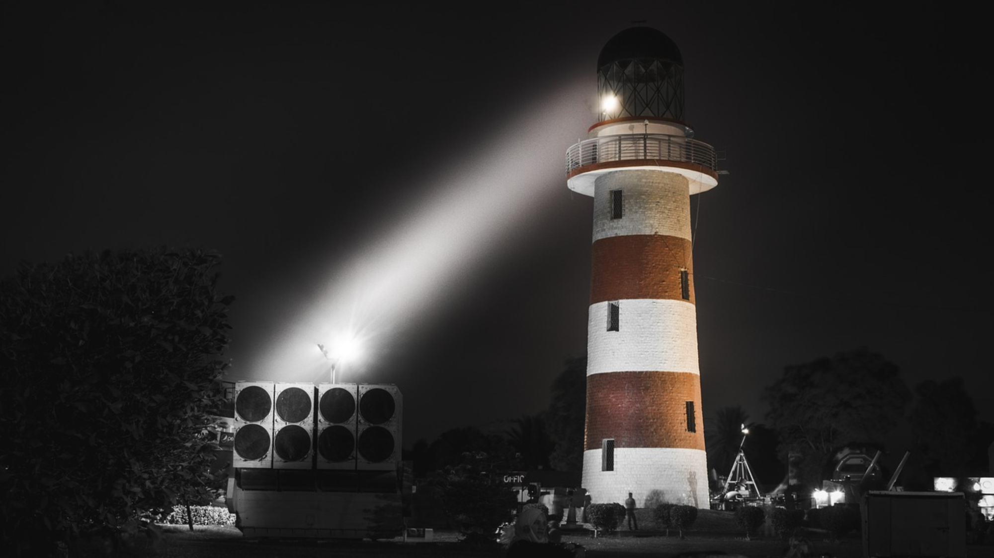
The IR Sensor System consists mainly of a transmitter and a receiver. It uses infrared light as a type of wireless communication. The transmitter emits a continuous beam of infrared light…

Slide 5
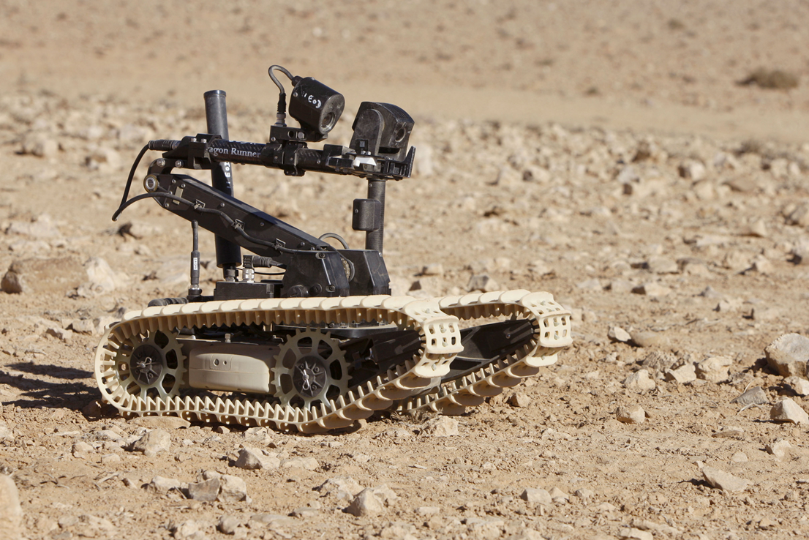
… while the receiver senses the light and will change the output from high to low when it detects infrared light. By running the transmitter and the receiver output line continuously, a device can become a line tracker.

Slide 6
What effects it
The BEST IR system relies on sensing infrared rays. Different lighting factors, such as sunlight and fluorescent light can affect the transmitter.
Sunlight is itself a composition of a range of waves including the IR waves.
So the receiver treats it as a signal.

Slide 7
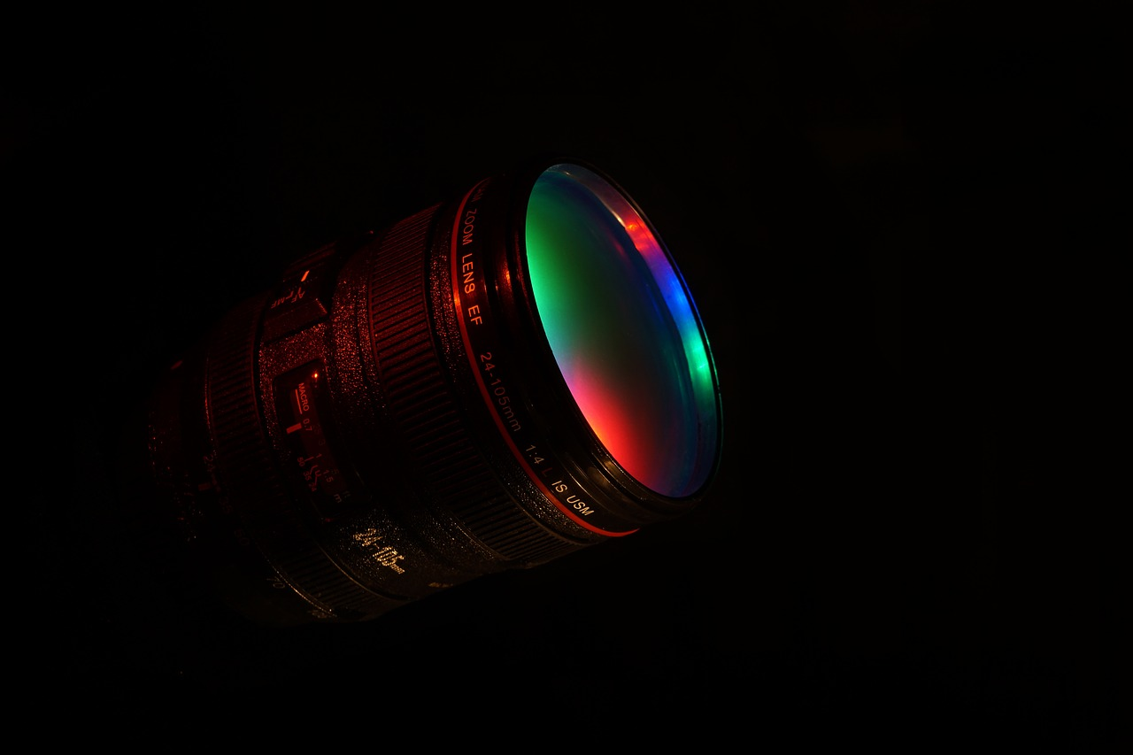
What effects it
Adding special receiver lenses can be added to block out the sunlight or any other type of light that causes interference.

Slide 8
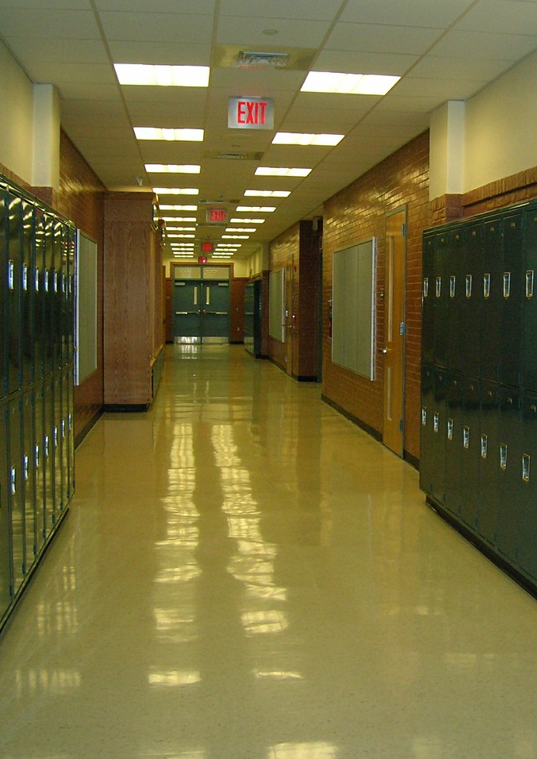
Inside a building, fluorescent lighting can adversely affect a transmitter. Fluorescent lights flash on and off 120 times each second. Our eyes don’t notice this action, but a fast-electronic detector will easily notice the flicker.
Your team will need to consider how to adapt to the environment in which your IR System will be working.

Slide 9
DIscussion
How do you think teams can resolves these problems when using the BEST IR Sensor SYstem?

Slide 10
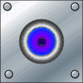
How BEST Robotics approaches the problem
The BEST IR system uses two techniques to minimize interference from our man-made light sources – the frequency of light used (its “color”) and the rate in which it is turning our light on and off (“modulation”).

Slide 11
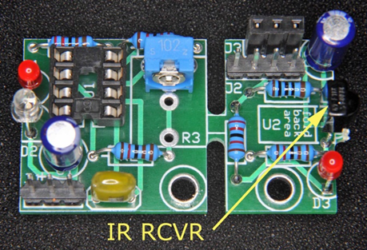
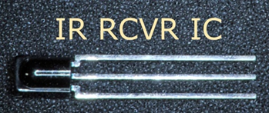
Color
Look at the IR detector. It looks almost black. Just as we can make plastic that lets red light thru but blocks blue or green light, we can make plastic that lets infrared light thru but blocks all the visible light colors. Such a plastic is used on the IR detector package. To us, it looks black because no visible light can get thru. It is transparent to IR light which passes easily to the detector chip.

Slide 12
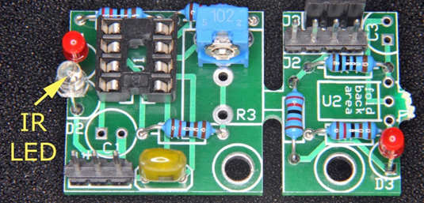
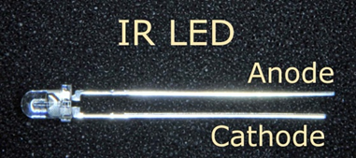
Modulation
The IR detector is also equipped to handle the modulation factor as well. Instead of merely producing IR light that is always on, we can modulate it by rapidly turning it on and off. In fact, our IR detector chip is designed with this in mind.
The IR transmitter emits infrared light modulated at a specific frequency. The transmitter used in this project will modulate the IR signals at nearly 38 KHz. The receiver will be looking for light that turns off and on 38,000 times per second and ignores any light that does not.

Slide 13
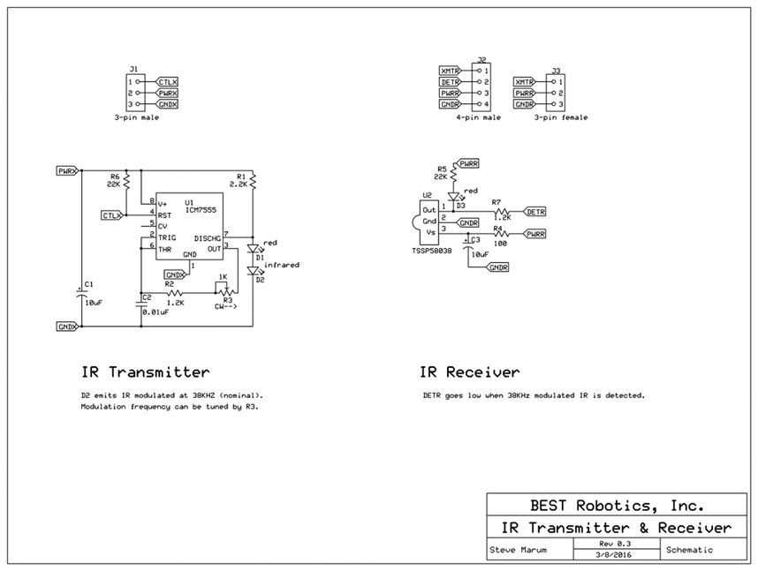
A Schematic demonstrates how the best robotics IR system works.

Slide 14
The IR Transmitter
D2 emits an IR modulated light at 38KHZ. The modulation frequency can be tuned by R3.
Can someone point out these components?

Slide 15
The IR Transmitter
DETR goes low when 38KHZ modulated IR is detected.
Can someone point out these components?

Slide 16
Competition connection
These circuits are versatile building blocks which can be used to do any of these things:
Beam Blocker: Run the transmitter continuously and use the receiver to detect when something blocks the light.
Line Follower: Run the transmitter continuously and use the receiver to detect the light reflected from a line under the robot
(Advanced)Simple Signaling: Communicate with another robot or the field by sending and receiving pulses of various widths, or different numbers of pulses.

Slide 17
DIscussion
What are some ways you would like to try using the IR system?

Slide 18
bEStology
For more STEM connection check out bESTology.
bESTology is a resource for schools (teams) participating in the nationwide BEST Robotics Program to learn educational and workforce development concepts revolving around the 2019 game.

Slide 19
Annotations
Slide 2: https://youtu.be/kcaoyXWEDCU
Slide 3:https://commons.wikimedia.org/wiki/File:Electromagnetic_spectrum_-eng.svg
Slide 4: https://pixabay.com/photos/lighthouse-night-light-military-2839951/
https://pixabay.com/illustrations/board-conductors-circuits-2965056/
Slide 5: https://upload.wikimedia.org/wikipedia/commons/8/88/Dragon_Runner_Bomb_Disposal_Robot_MOD_45159060.jpg
Slide 6: https://pixabay.com/photos/sunrise-sun-clouds-sky-mood-3533173/
Slide 7: https://pixabay.com/photos/lens-telephoto-lens-photograph-3088589/
Slide 8: https://pixabay.com/photos/school-lockers-hallway-high-school-417612/
Slide 9: https://pixabay.com/illustrations/banner-header-question-mark-1090830/
Slide 10: https://upload.wikimedia.org/wikipedia/commons/b/bf/Blue_flashing_light.gif
Slide 17: https://pixabay.com/illustrations/banner-header-question-mark-1090830/

