Slide 1
Electronics Fundamentals
Best Robotics 2019

Slide 2
Types of Electricity

Slide 3
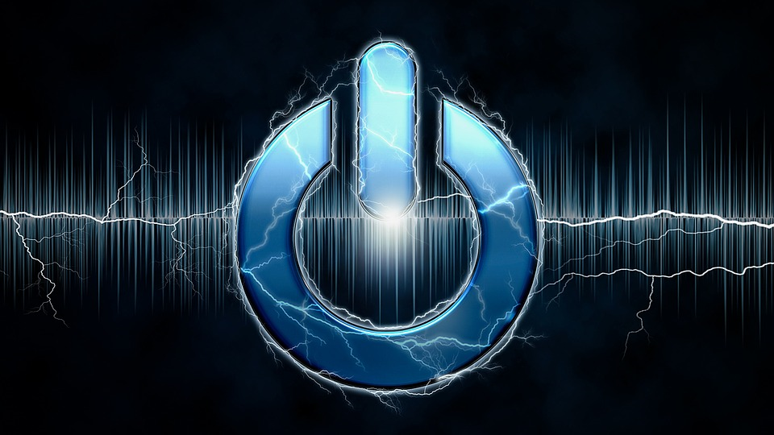
Electricity is a form of energy. It is a “charge” of electrons that can exist as either Static Electricity (electrons waiting to move) or an Electric Current (moving electrons).
What is Electricity?

Slide 4
Electricity is used to power many things in our daily lives in and out of school.
Can you name some?
Lamps
Stoves
Ovens
Can Openers
Air Conditioners
Televisions
Phones
Computers
Cars
Where Do We Find it?

Slide 5
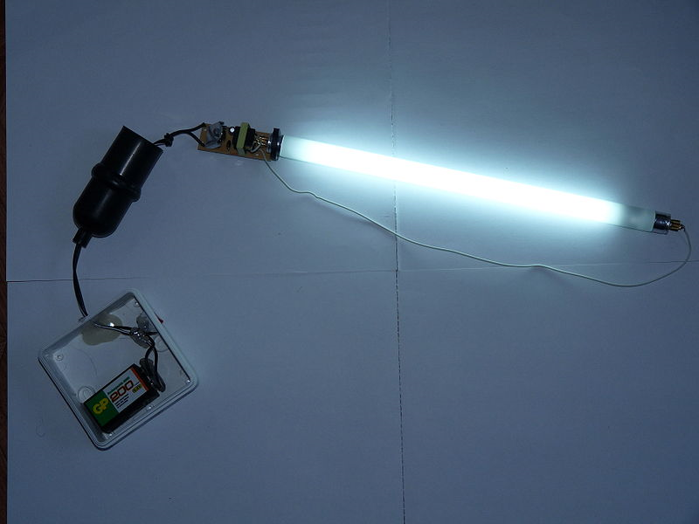
Electric Current vs. Static Electricity
Electric Current
For electrons to move and achieve an electric current (through a wire for example), a closed loop is required. The electrons will flow through certain types of materials (conductors) only when there is a closed loop. As seen in the figure, connecting a lamp to a battery will create a closed loop from the negative battery terminal, through the lamp, and back to the positive battery terminal. In this case, electric current will flow from the battery through the wire and lamp causing it to light up.

Slide 6
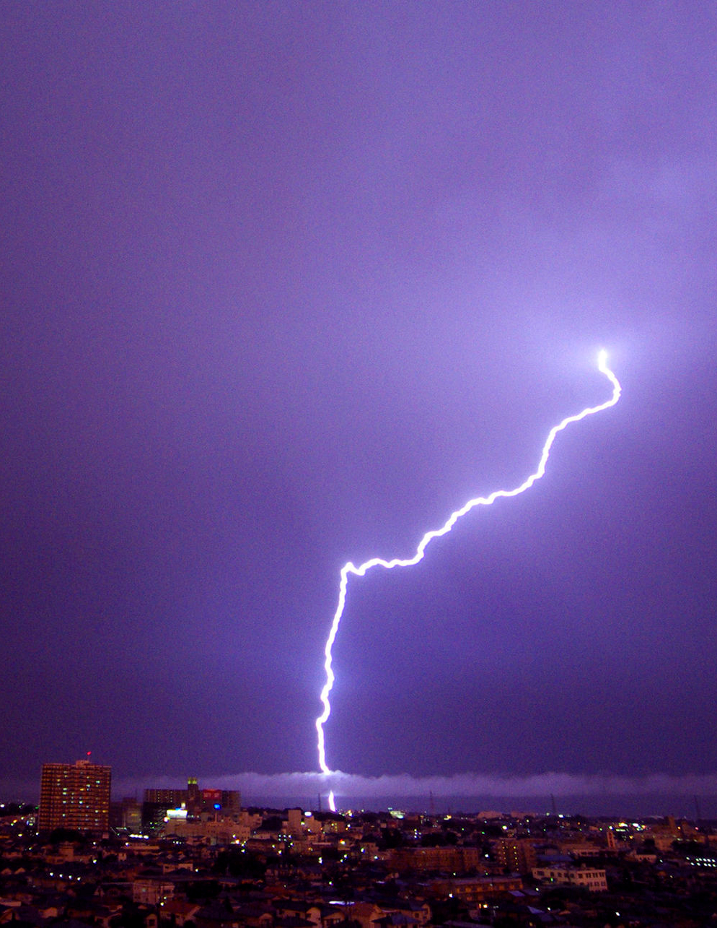
Electric Current vs. Static Electricity
Static Electricity
Static electricity, on the other hand, is a build up of electrons in one place. Static means stationary/not moving. The Static electricity will eventually discharge or move but only for a very short time. A good example is lightening in a storm. Electrons (electric charge) build up in the clouds and when large enough will move (or jump) to the ground which we see as a streak of light in the sky.

Slide 7
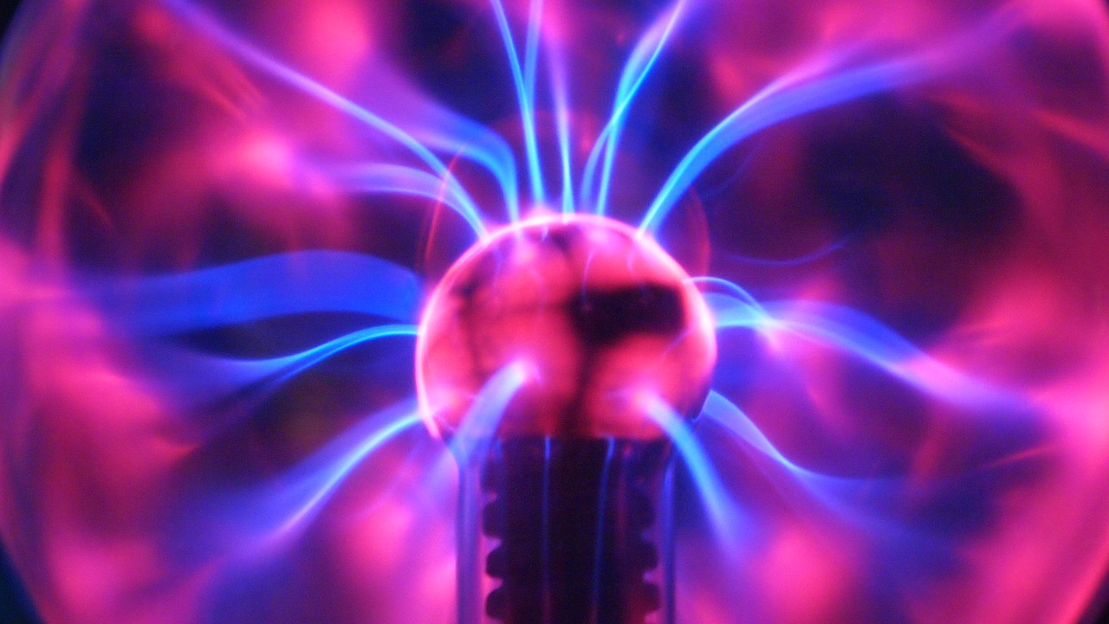
Electric Current vs. Static Electricity
Discussion Question: Can you think of another example of static electricity?
One example is when you get shocked by touching a door knob or other metal object. Electrons can build up on your body as you move across the floor (and in many other ways). When you touch the metal object (a material that conducts electricity), electrons jump between your body and the object creating a very short spark.
Static electricity moves or discharges only once; it is not an electric current which is a continuous flow of electrons.

Slide 8
Using Electric Circuits

Slide 9
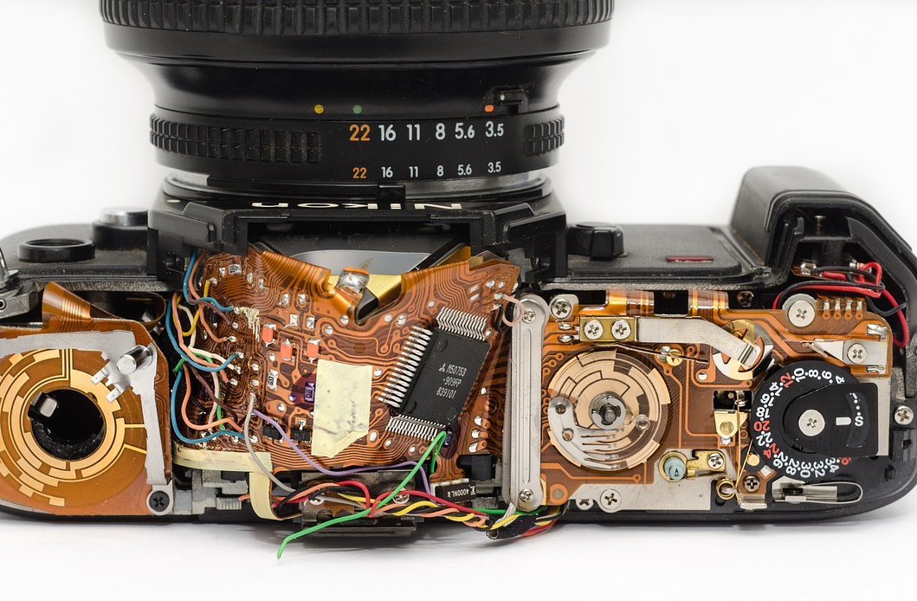
Electric Circuits
In the previous electric current example, we saw the battery and lamp closed loop. It is known as an electric circuit.
Electric circuits can be found in all many places throughout your home and school. This camera is just one example.

Slide 10
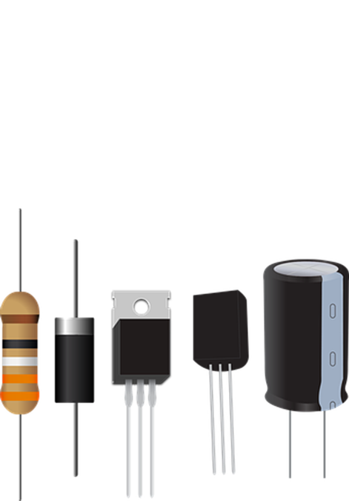
Electrical Components
Electric circuits are made up of various electronic components. You will get to learn more about them as you create your own circuit boards. You may recognize some.
Resistor- device having a designed resistance to the passage of an electric current.
Transistor-semiconductor device with three connections, capable of amplification in addition to rectification.
Capacitor- device used to store an electric charge, consisting of one or more pairs of conductors separated by an insulator
Inductor- component in an electric or electronic circuit which possesses inductance
Diode-semiconductor device with two terminals, typically allowing the flow of current in one direction only.
LED (light-emitting diode) -a two-lead semiconductor light source.

Slide 11
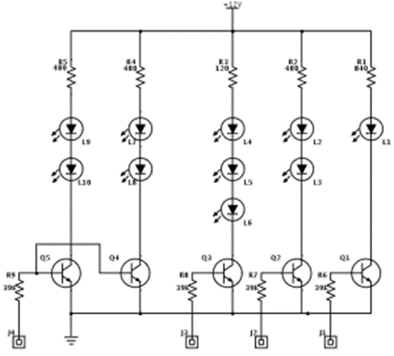
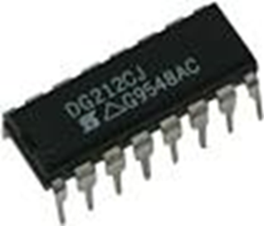
Electric Schematic
To make any electronic circuit, you start with a schematic diagram. A schematic is a drawing of a circuit. It tells you which components are needed and how to connect these components.
Each component is represented by a special symbol in the schematic. When an electronic circuit is shrunk and squeezed into a single package, it is called an “integrated circuit” or “IC”.
IC technology is a detailed topic that can be further researched on your own.

Slide 12
Electric Schematic
Watch the video below to learn more about schematics.

Slide 13
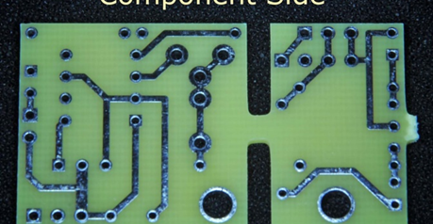
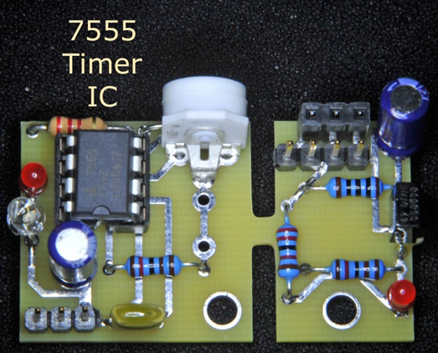
Printed Circuit Boards
From the schematics, we design a printed circuit board (PCB) to hold all the components.
The wires from the schematics and placeholders for the different components (holes) are drawn (or etched) in metal onto a fiberglass board.
The components are then soldered to the board to create the electronic circuit board which we then can use.

Slide 14
Using Electric Circuits
Discussion Question: What are some parts of an electronic circuit?
1. Resistors, Transistors, LEDs, Diodes, Capacitors, Inductors
2. Printed Circuit Boards
Discussion Question: What acts like a map when creating an electric circuit?
A schematic

Slide 15
Working with Electric Circuits

Slide 16
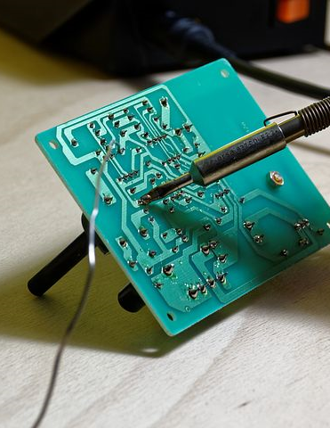
Soldering
Soldering is the way in which the electrical components are attached to the Printed Circuit Board.
Soldering is a process in which two or more items are joined together by melting solder into the joint.

Slide 17
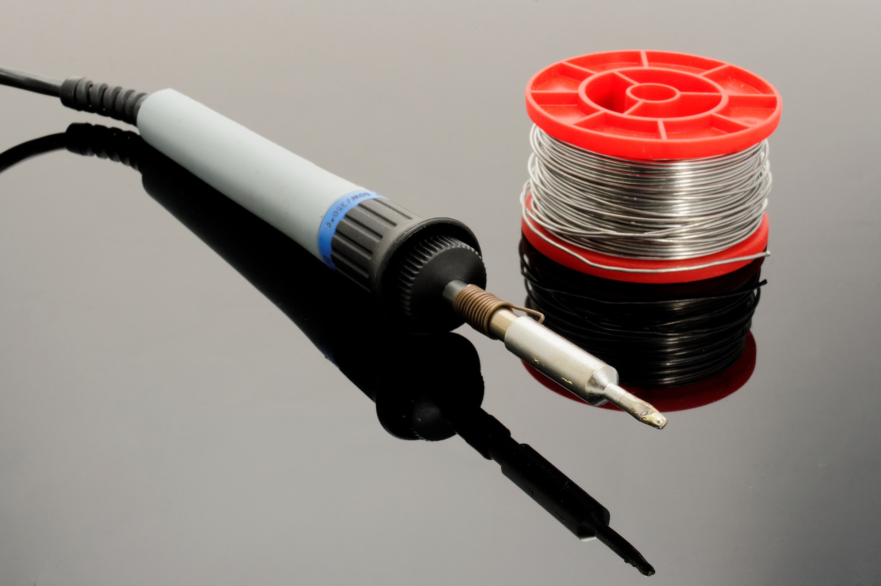
Soldering Safety
There are many safety rules we will follow when we solder. Especially since we are working in a group. Why do you think we need to be careful when soldering?
We do not want to get burned or damage any of the components.
How can we damage the components?

Slide 18
Sensitive Electronic Components
Some electronic components are sensitive to Electro-Static Discharge (ESD). This is the same thing as the static electricity that causes sparks when it moves. This static electric “discharge” can cause damage to the electronic components we will work with.
We must take precautions to make sure that we do not have any Static Electricity build-up in our bodies before handling these sensitive components.

Slide 19
Sensitive Electronic Components
There are two categories of damage from ESD:
Catastrophic Damage – the electronic device is inoperable immediately after the ESD event.
Latent Damage – the electronic device appears to be working fine following the ESD event. However, the damaged circuit could fail to operate properly at some time in the future. (Hopefully not in the middle of a competition.)

Slide 20
Exploring ESD
To learn more about Electro-static Discharge, click on the video below.

Slide 21
How Circuits Work

Slide 22
Electric Circuits
Once we put our circuits together, we need to understand how they work. Ohm’s Law can help us .The law was founded by Georg Ohm and is based on how the three most important parts of an electric circuit are related.
Can you guess what they are?
Voltage – Voltage is the potential energy, energy that pushes the electric current through the circuit; it is measured in Volts.
Resistance – Resistance is how much an electric circuit opposes current flow; it is measured in Ohms.
Current – Current is the amount of flowing electrons (or electric charge); it is measure in Amperes (Amp), or milliAmperes (1/1000th of an Amp).

Slide 23
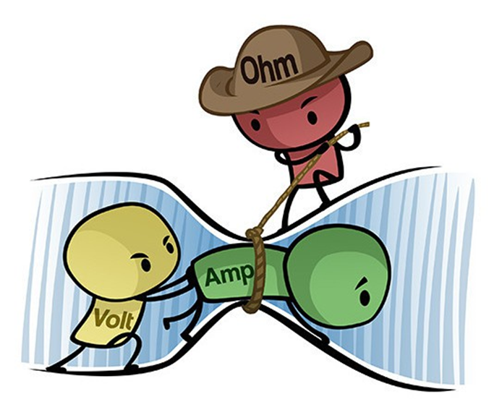
Ohm’s Law
Look at the drawing and see if it makes sense to you that:
If you increase the voltage in a circuit while the resistance is the same, you get more current.
If you increase the resistance in a circuit while the voltage stays the same, you get less current.

Slide 24
Ohm’s Law
V = RI
Ohm’s law is a way of describing the relationship between the voltage, resistance, and current using math.
V is the symbol for voltage.
I is the symbol for current.
R is the symbol for resistance.
You can switch it around and get R = V/I or I = V/R.
If you have two of the variables, you can calculate the last.

Slide 25
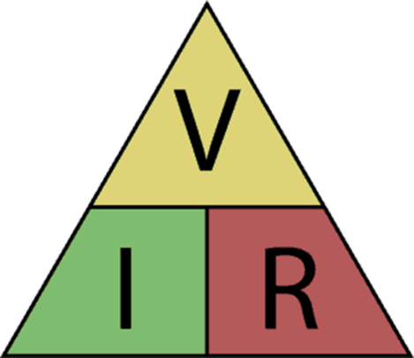
Ohm’s Law Triangle
You can use this triangle to remember Ohm’s law:
How to use it: Use your hand to cover the letter you want to find. If the remaining letters are over each other, it means divide the top one with the bottom one. If they are next to each other, it means multiply one with the other.

Slide 26
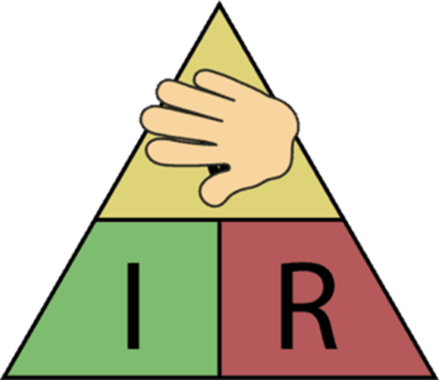
Practice: Find the Formula for Voltage
Place your hand over the V in the triangle.
Look at the R and the I.
I and R are next to each other, so multiply.
V = I * R

Slide 27
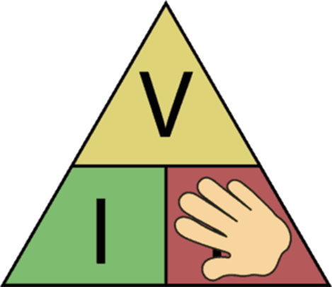
Practice: Find the Formula for Resistance
Place your hand over the R in the triangle.
See that the V is over the I.
That means you must divide V by I.
R = V / I

Slide 28
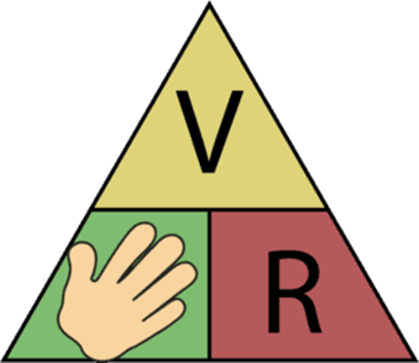
Practice: Find the Formula for Current
Place your hand over the I in the triangle.
See that the V is over the R.
That means you must divide V by R.
I = V / R

Slide 29
Application of Ohm’s Law
This is a very simple circuit with a battery and a resistor. The battery is a 12 volt battery, and the resistance of the resistor is 600 Ohm. How much current flows through the circuit?
To find the amount of current, you can use the Ohm’s Law triangle to find the formula for current: I = V/R. Now you can calculate the current by using the voltage and the resistance:
I = 12 V/600 Ohm
I = 0.02 A = 20 mA (milli Ampere)
So the current in the circuit is 20 mA.

Slide 30
References
References/Sources:
https://www.build-electronic-circuits.com/how-to-learn-electronics/
https://library.automationdirect.com/basic-electrical-theory/
https://www.build-electronic-circuits.com/ohms-law/

Slide 31
Annotations
Slide 3: https://pixabay.com/illustrations/background-wallpaper-energy-1872802/
Slide 4: https://pixabay.com/photos/earth-planet-continents-light-pear-2581631/
Slide 5: https://commons.wikimedia.org/wiki/File:Fluorescent_light_bulb_using_9V_battery_as_source.JPG
Slide 6: https://commons.wikimedia.org/wiki/File:Thunder_at_Saitama_2.jpg#/media/File:Thunder_at_Saitama_2.jpg
Slide 7: https://pixabay.com/photos/plasma-bal-purple-bright-electrical-2747457/
Slide 9: https://pixabay.com/photos/camera-inside-mechanics-technician-943244/
Slide 12: https://youtu.be/_HZ-EQ8Hc8E
Slide 14: https://pixabay.com/photos/plasma-bal-purple-bright-electrical-2747457/
Slide 16: https://pixabay.com/photos/solder-soldering-station-tin-board-1038523/
Slide 17: https://pixabay.com/photos/soldering-iron-solder-1038540/
Slide 18: https://pixabay.com/photos/current-electric-charge-electricity-3763664/
Slide 19: https://pixabay.com/images/search/circuit%20smoke/
Slide 20: https://youtu.be/bWXNOemu2j4

